Slide 1
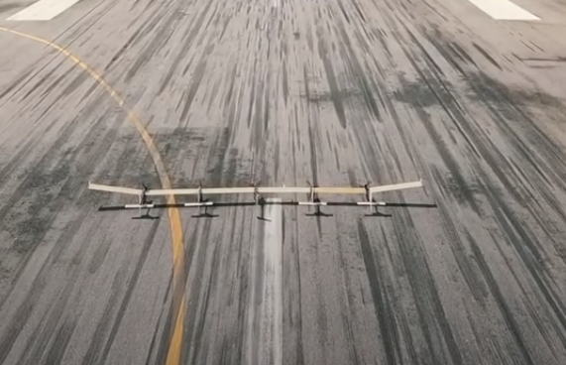
Aeroelastic Analysis and Optimization of a Highly Flexible Aircraft and Application at X-HALE-BR
Francisco Arthur Bonfim Azevedo
Tutor: Joseph Morlier
20/05/2020

Slide 2
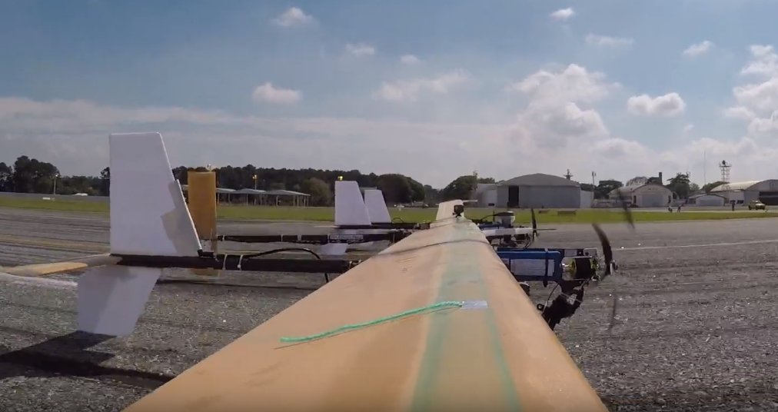
Introduction

Slide 3
Introduction
First of all, the object of study is a Brazilian highly flexible aircraft, called X-HALE-BR
To this work, an aeroelastic analysis was proposed for this type of aircraft, followed by an optimization of the model, achieving the improvement of the aeroelastic characteristics of the aircraft without compromising its flexibility

Slide 4
The Methodology

Slide 5
The Methodology: past works
In the literature, there is some modelling of this problem:
Weihua Su, 2008 [1]
Flavio Ribeiro, 2012 [2]
Van Schoor, 1989 [3]

Slide 6
The Methodology: past works
In the literature, there is some modelling of this problem:
Weihua Su, 2008 [1]
Flavio Ribeiro, 2012 [2]
AeroFlex Toolbox
Van Schoor, 1989 [3]
Originally made for the same aircraft in study.
Come with a Matlab’s Toolbox.
Recent and updated work.
The work may be done in contact with Flavio.
It has really precise results in comparison with other works and experimental data.

Slide 7
The Methodology: the present work
Flexible Wings
Aeroelastic Analysis
Rigid Wings
AeroFlex
It is possible to chose between some aerodinamic models
A really complete modelling for flexible aircrafts, including aeroelastic analysis, flight dynamics, and other functionalities.
Flight Dynamics
The aeroelastic model will be used with less options for the user, to simplify the initial work.

Slide 8
The Methodology: the present work
Aeroelastic Analysis
Mesh creation
Aerodynamic model
Visual feedback for the user
User Interface (GUI)
Nodes
Elements
Complete aircraft (including fuselage and motors)
Unsteady model based in Peters et al. (1995) [4]
At this point it is possible to start the optimization

Slide 9
The Methodology: the future work
Aircraft general parameters
Optimization
Optimization of composite layers (direction, material, number of layers)

Slide 10
Bibliography
Su, Weihua. Coupled Nonlinear Aeroelasticity and Flight Dynamics of Fully Flexible Aircraft. Diss. 2008.
Ribeiro, F., et al. "Aeroflex: a toolbox for studying the flight dynamics of highly flexible airplanes." Congresso Nacional de Engenharia Mecânica. 2012.
Van Schoor, Marthinus C., and Andreas H. von Flotow. "Aeroelastic characteristics of a highly flexible aircraft." Journal of Aircraft 27.10 (1990): 901-908.Dowell, Earl H. A modern course in aeroelasticity. Eds. Howard C. Curtiss, Robert H. Scanlan, and Fernando Sisto. Vol. 3. Dordrecht, The Netherlands: Kluwer academic publishers, 1989.
Peters, D., Karunamoorthy, S. and Cao, W., 1995. “Finite state induced flow models. i: Two-dimensional thin airfoil”.Journal of Aircraft, Vol. 32, No. 2, pp. 313–322.

Slide 11




Thank You

Slide 12
Questions?

